Slide 1
Exercise session #3
Science of
Climate Change
Sept. 25, 2025

Slide 2
Topics
Introduce assignment
Recap from lecture + quiz
Exercise on radiation and greenhouse gases
Time to work on your assignment

Slide 3
Assignment
25 % of the final grade
Groups of 4 people
Submit on Moodle as a .pdf document (no scan of handwritten notes)
Each group must submit a unique report with all their names on the first page.
Respect the line limit when answering questions
File naming convention: The file name should be as follows: Group X ENV410 assignment.pdf (X = group number)
Deadline: Monday, 27 November 2025, at 23:59.
TAs will be available for questions during the exercise sessions

Slide 4
Recap from lecture

Slide 5
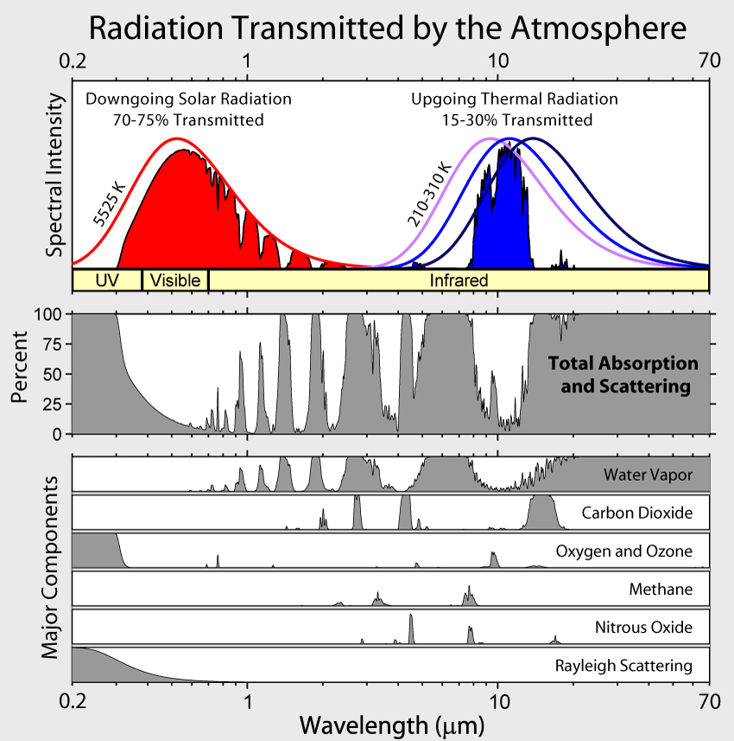
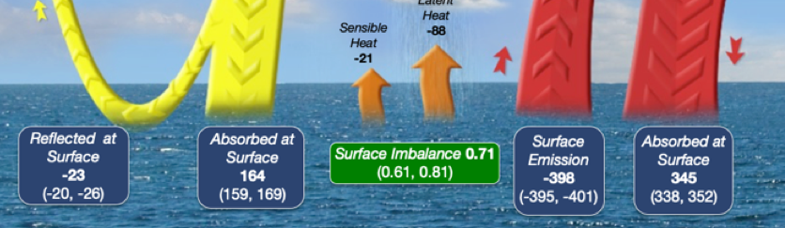
Greenhouse effect
Solar radiation is transmitted through Earth’s nearly transparent atmosphere (transparent to shortwave radiation).
Earth’s surface absorbs the solar radiation and warms.
The Earth emits thermal IR radiation (blackbody radiation).
The atmosphere is much less transparent to thermal infrared radiation and absorbs it.
The absorbed radiation leads to warming of the atmosphere, which in turn emits thermal IR radiation in all directions, but also partly downwards.
So the net thermal IR flux from the Earth (as blackbody) to space is greatly recuded. This diminishes the radiative cooling of the Earth’s surface and leads to surface warming.

Slide 6
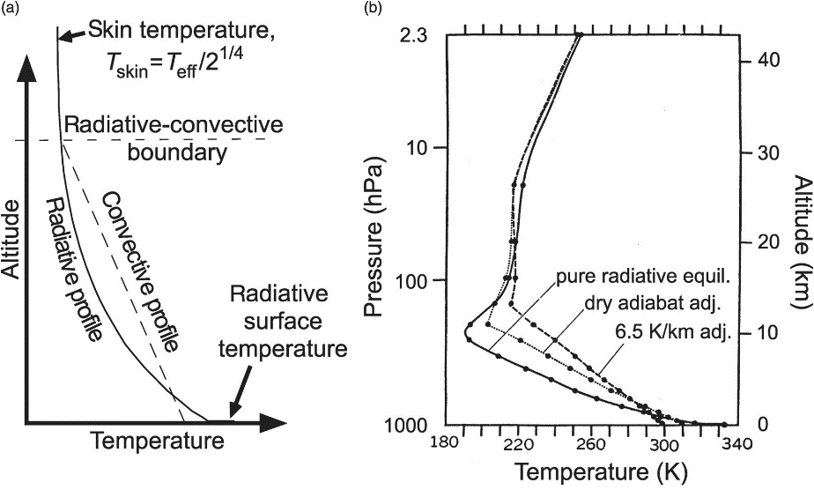
Convective - radiative equilibrium
Further aloft in the troposphere, the re-emission of IR radiation by infrared-active gases and clouds leads to a net energy loss of the atmosphere.
In fact, convective transport of sensible and latent heat of water vapor cools the surface and warms the troposphere and leads to the observed lapse rate of -6.5 K / km.
Because the density of the atmosphere increases close to the surface, the layers become optically thicker and physically thinner. Hence, removing heat near the surface becomes difficult.
If only radiative equilibrium were responsible for the energy balance, Earth’s surface would be very hot!
equil. = equilibrium
ajd. = adjustment
Catling, D., & Kasting, J. (2017). Principles of Planetary Atmospheres. In Atmospheric Evolution on Inhabited and Lifeless Worlds (pp. 1-168). Cambridge: Cambridge University Press. Wallace and Hobbs, 2006, Ch. 4.3.6
Notes:
The surface radiation is difficult to remove, so the surface warms a lot. That produces convection of the warm air masses upwards.
(the more GHG, the more the lapse rate will increase to equilibrate the temperature loss.

Slide 7
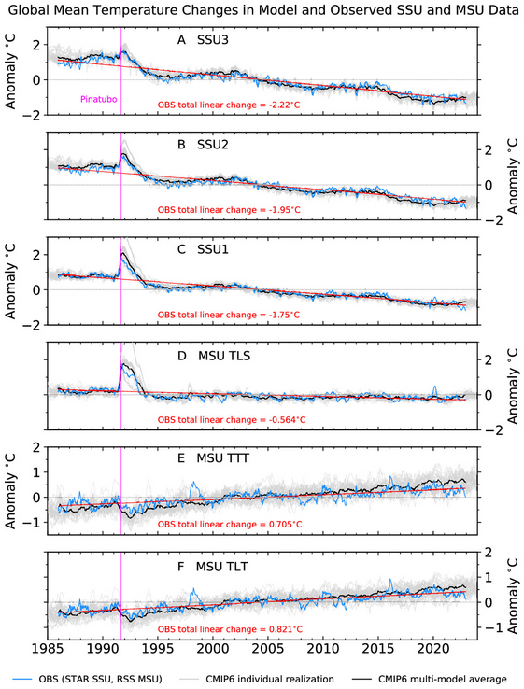
Stratospheric cooling
45 km
The stratosphere has been cooling as the troposphere is warming.
Contributing effects are:
  Depletion of the ozone layer. Ozone is a greenhouse gas. Less ozone means less IR absorption.
  More CO₂ in the troposphere means that the flux of 15 µm IR to the stratosphere is diminished. So stratospheric CO₂ absorbs less IR while emitting the same amount.
38 km
30 km
19 km
5.6 km
3.1 km

Slide 8

Quiz - Mentimeter
Notes:
https://www.mentimeter.com/app/presentation/aljdhf2s3q8gy7ms9yby8v1zwo6x25g8/

Slide 9
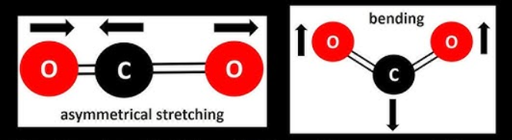
Mentimeter solutions
Rank the following in order from high to low albedo:
  Fresh snow => sand => grass => ocean
The earth's equilibrium temperature is smaller than its actual temperature. (True)
  Without (natural) GHG warming earth temperature would be around -18C
How many atoms does a molecule need to absorb infrared light? (exactly 2, exactly 3, 3 or more)
2 atoms is not enough as absorption leads to a change in dipole moment

Slide 10
Mentimeter solutions
Which is the most abundant greenhouse gas? (CO₂, H₂O, O₃, CH₄)
Greenhouse gases are most effective in absorbing which type of radiation? (Visible, Microwave, Infrared, Ultraviolet)
The type of radiation that GHGs are most effective at absorbing is also called: Longwave/Shortwave
Even though water vapor is a stronger greenhouse gas overall, why does adding CO₂ still cause significant warming?
  CO₂ significantly absorbs solar (shortwave) radiation
  CO₂ absorbs primarily in the 15 µm band where H₂O absorption is weaker
  CO₂ is present in higher concentrations than H₂O in the atmosphere
  CO₂ absorbs in the same bands as H₂O, amplifying H₂O absorption

Slide 11
Mentimeter solutions
Which of the following gases is well mixed throughout the troposphere (spatially uniform in concentration)?
  (H2O, CH4, CO2, O3)
What are the key factors to an effective greenhouse gas?
  High radiative forcing
  Long lifetime
  High concentration

Slide 12
Exercises

Slide 13
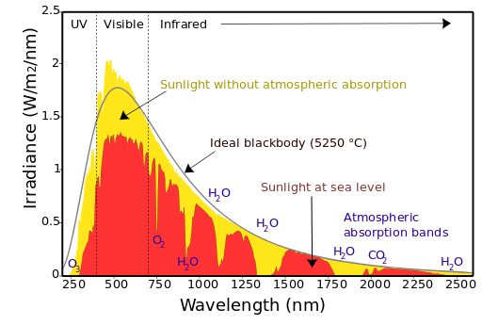
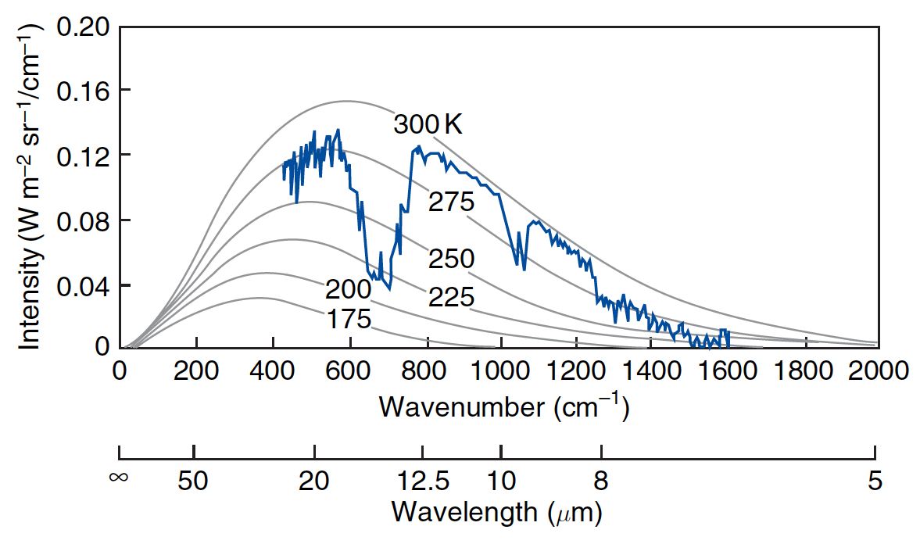
Exercise 2
Spectrum of the Sun (left) and the Earth (right).

Slide 14
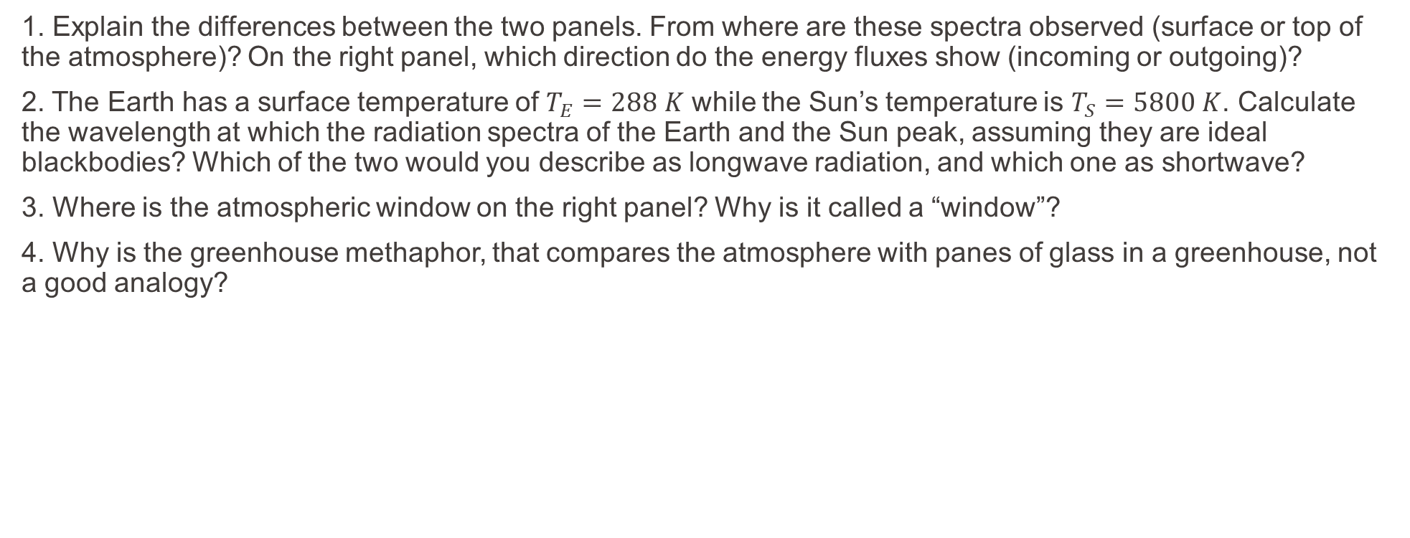
Exercise 2
1. Explain the differences between the two panels. From where are these spectra observed (surface or top of the atmosphere)? On the right panel, which direction do the energy fluxes show (incoming or outgoing)?
2. The Earth has a surface temperature of $T_{E}=288 K$ while the Sun’s temperature is $T_{S}=5800 K$. Calculate the wavelength at which the radiation spectra of the Earth and the Sun peak, assuming they are ideal blackbodies? Which of the two would you describe as longwave radiation, and which one as shortwave?
3. Where is the atmospheric window on the right panel? Why is it called a “window”?
4. Why is the greenhouse methaphor, that compares the atmosphere with panes of glass in a greenhouse, not a good analogy?

Slide 15
Exercise 2 – Solution
1. Explain the differences between the two panels. From where are these spectra observed (surface or top of the atmosphere)? On the right panel, which direction do the energy fluxes show (incoming or outgoing)?
Absorption by GHG
Incoming shortwave solar radiation
Yellow: top of the atmosphere
Red: at the surface
Outgoing longwave terrestrial radiation
Top of the atmosphere

Slide 16
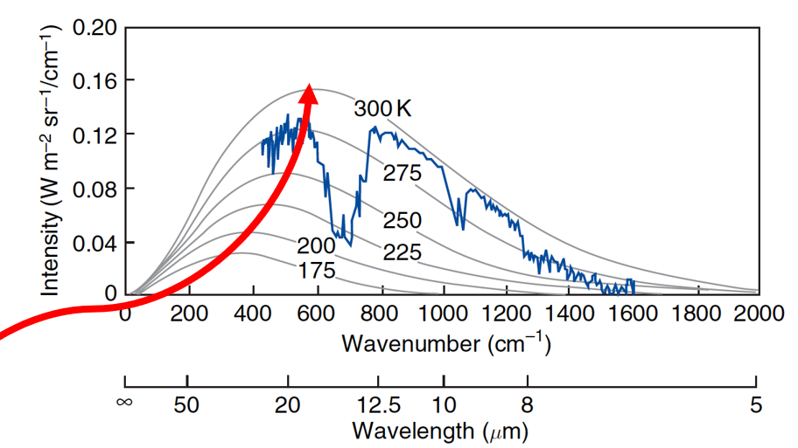
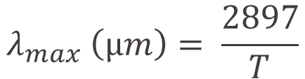

Exercise 2 – Solution
The Earth has a surface temperature of $T_{E}=288 K$ while the Sun’s temperature is $T_{S}=5800 K$. Calculate the wavelength at which the radiation spectra of the Earth and the Sun peak, assuming they are ideal blackbodies? Which of the two would you describe as longwave radiation, and which one as shortwave?
Wien’s law:
For the Sun: $λ_{max}$ = 0.5 $μ$m (shortwave)
For the Earth: $λ_{max}$ = 10 $μ$m (longwave)
$$λ_{max} \left(µm\right)= \frac{2897}{T}$$

Slide 17
Exercise 2 – Solution
3. Where is the atmospheric window on the right panel? Why is it called a “window”?
Atmospheric window
Absorption by GHG
It is called a window because, for these wavelengths, the atmosphere is transparent (radiation is not absorbed) and radiations can pass the atmosphere to space.

Slide 18
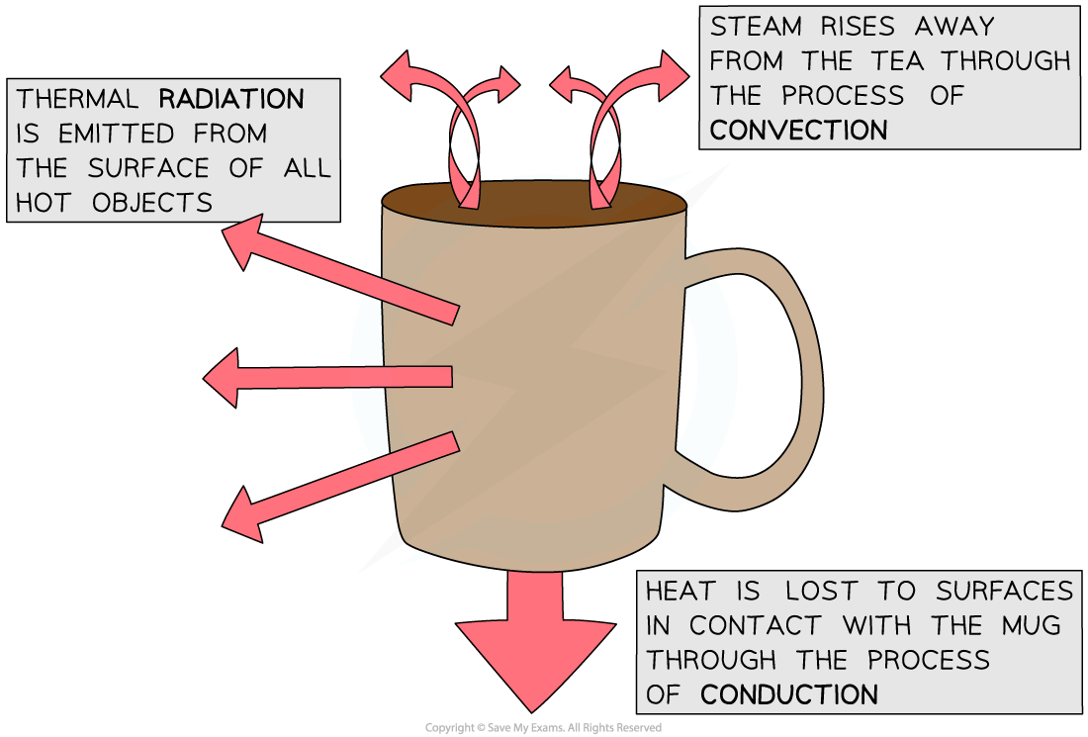
Exercise 2 – Solution
4. Why is the greenhouse methaphor, that compares the atmosphere with panes of glass in a greenhouse, not a good analogy?
They actually operate according to different principles. What happens inside a greenhouse is a process of thermal convection – glass panes of a greenhouse form a “blanket” that completely cuts off the upward heat flow. However, the atmosphere heats up the Earth through a process of thermal radiation.

